Slide 1

Detecting SQL Injections using AST
Prepared by:-
Kirti Chiplunkar 15
Sonal Dimbar 19
Stuti Thorat 74
Notes:
1

Slide 2
Introduction
The growth of internet is increasing day by day.
Ignoring essential security and privacy measures may lead to data breach.
SQL Injection Attack is one of the most popular hacking techniques, but also one of the oldest.
65% of all Web Application attacks are SQL injection attacks.
Notes:
2

Slide 3
SQL Injections
SQL injections is a code injection technique used to attack data driven applications in which malicious SQL statements are inserted into an entry field for execution.
SQL injection attacks lead to:
allowing attackers to spoof identity
tamper existing data
allow complete disclosure of all data on the system
become administrators of the database server.

Slide 4
Abstract Syntax Tree(AST)
Python has a built-in AST module that lets you inspect ,parse and edit code.
AST is a data structure that makes it easy to analyze ,inspect and edit programming language code.
Abstract trees represents relation between objects, operators and language expressions
After traversal of the ASTs if difference are found ,then an SQL injection is reported.

Slide 5
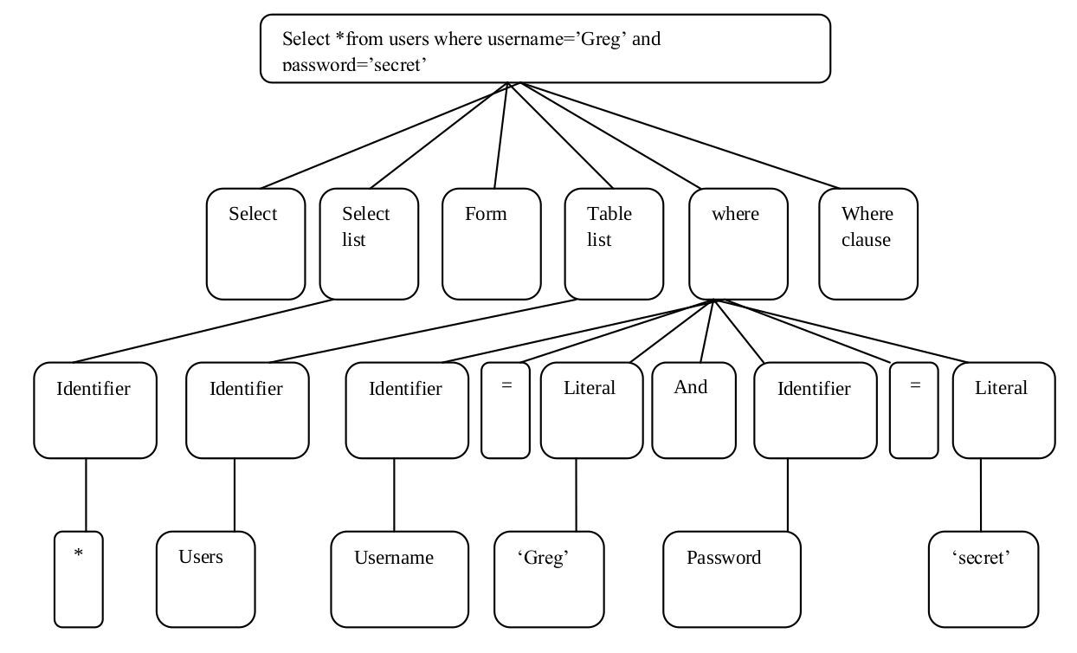
Example of AST

Slide 6
Conclusion
It can be concluded that development of effective solutions for prevention and detection of SQL injection attacks is therefore of utmost importance to secure the web applications from being exploited by the attackers.
Unfortunately ,these security aspects are often overlooked or given less priority during application development.
As a result, theft of huge amount of sensitive data using SQL injection attacks have become very common.
So using the AST technique some of these threats can be detected and also be corrected at some extent.

